Slide 1
Personalized Job Recommendation
APAN 5430 - Group 4
Minkyung Kim | Boni Rosen | Kibaek Kim | Kas Kiatsukasem | Philip Suchakrey

Slide 2
Table of Contents
APAN 5430
1
Business Background & Problem
2
Data source & Procurement
3
Selected technologies & Rationale
4
System Development Process
5
Results & Evaluation
6
Limitations & Opportunities for Improvement
7
UI Demo

Slide 3


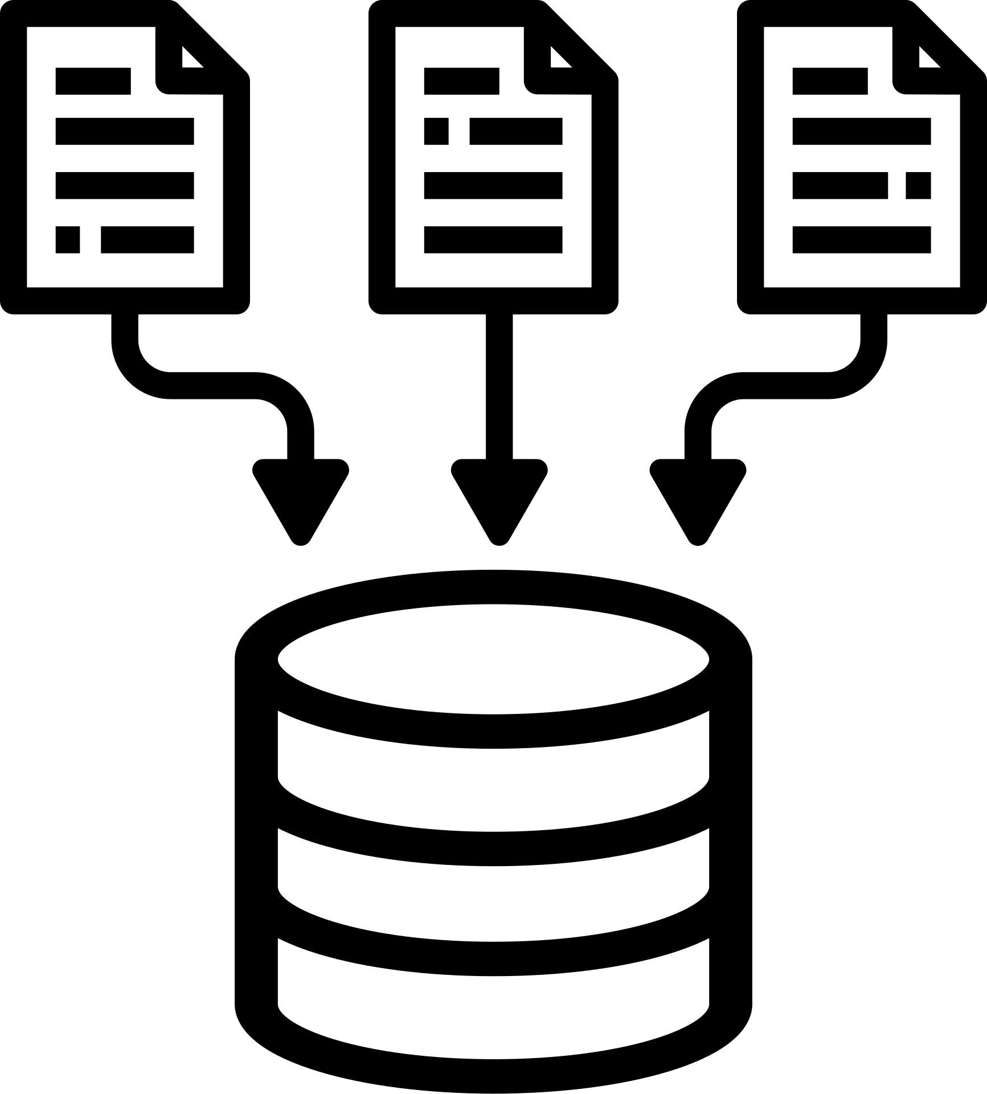
Business Background & Problem
In an online job application portal and ATS today, most recruitments are relying on keyword-based search and macthing where recruiters enter skill keywords or technical skill, and candidates are ranked only by those texts overlap.
This approch overlooks:
Candidate contextual relevance
Full story of candidate’s background
System overlooks lead to:
Missed the right candidate opportunity
Poor overall match quality
Project Goal and Use Case
The goal of this project is to develop a personalized job recommendation system:
Calculates a match score between a candidate’s resume & job descriptions
Rank job postings by compatibility, showing the most relevant and well-aligned positions first, based on both explicit qualifications and implicit signals
Provides resume improvement recommendation using LLM
Use case:
Candidate side: Upload their resumes to receive a ranked list of job openings that best fit
Recruiter side: Identify the most relevant candidates based on overall profile similarity.

Slide 4

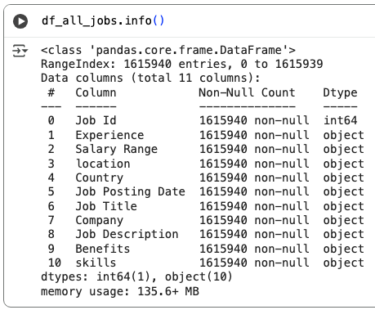

Data source
Linkedin
Job Title - The title of the job position
Company - The company name
Company Link - URL link to the company
Date - The date the job was posted
Date Text - Text representation of the date
Job Link - URL link to the job posting
Insights - Additional insights about the job
Description Length - The character count of the job description
Description - The full text of the job description
The goal is to combine data from two sources:
LinkedIn Job Board: Most up-to-date and realistic job postings
Hugging Face job dataset: to ensure sufficient data volume and diversity of jobs listed
Web Scraping from Linkedin Job Board
Scraped ~30K LinkedIn job posts using linkedin_jobs_scraper
100 predefined titles (e.g., Digital Marketing Specialist)
Extracted fields: Job Title, Company, Date, Link, Insights, Description
Saved up to 10K records per JSON file ( 30K Total )
Hugging Face
Job Description Data Set
The raw data source contained 22 columns with details about job opportunities. We adjusted the dataframe and filtered unnecessary columns. Finally, we have ~1GB data set filtered and includes only 10 important columns for the project
Source: https://huggingface.co/datasets/lof223/job_description
Combined Dataset Size: 1.2GB
*Final columns in each data sources
Notes:
Scraped ~30K LinkedIn job posts using linkedin_jobs_scraper
100 predefined titles (e.g., Digital Marketing Specialist)
Headless Chrome with random 1–4 min pauses to avoid detection
Extracted fields: Job Title, Company, Date, Link, Insights, Description
Saved up to 10K records per JSON file ( 30K Total )

Slide 5
Selected technologies & Rationale
01
03
Named Entity Recognition
02
Word/Sentence Embedding
Topic Modeling
Purpose:
To extract explicit, factual entities from resumes and job descriptions.
Detects skills, company names, job titles, certifications, degrees, and other key entities.
Captures what the candidate knows or has done.
Purpose:
To measure contextual similarity between Resume and JD text.
Computes similarity between the two embeddings to evaluate semantic closeness.
Captures what the candidate meant in the resume, even when the wording is different.
Purpose:
To identify which domain or industry topics each document belongs to (e.g., Data Science, Finance).
Trains an LSA model on JD text to learn latent topic distributions.
Captures whether both texts belong to the same industry or domain.
NER: Skill Score
Word Embedding: Semantic Score
Topic Modeling: Topic Score
Integrated Scoring Engine - Job Recommendation
Candidate Matching Score Formula: 0.45×SkillScore+0.35×SemanticScore+0.20×TopicScore
avg_topic_semantic = (topic_score + semantic_score) / 2
Selected Final Job Matching Score Formula = avg_topic_semantic + (1 - avg_topic_semantic) * skill_score
Notes:
Each score measures a different dimension of “fit.”
They are combined through weighted aggregation to compute the overall match score.

Slide 6
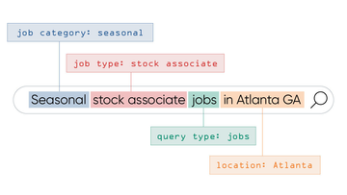



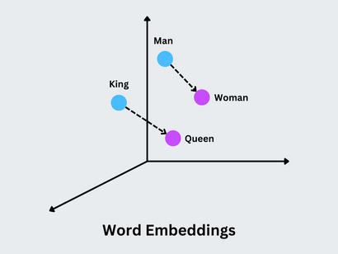




Design Structure
3
NER
(Explicit Matching)
1
2
Word Embedding
(Contextual Matching)
4
5
6
Data Source
Preprocessing
Final Job Matching Score
LLM Evaluation & Recommendation
UI
Topic Modeling
(Domain Matching)

Slide 7
Development Process

Slide 8
Data Cleaning
Resume
Job Post
Text extraction using pymudpf package
Text Cleaning & Normalization
Remove Invisible Characters
Remove Personal Identifiable Information sections (Name, Emalil, Address)
Strip HTML and Special Entities
Whitespace & Layout Cleaning
Reformat Bullet Points & Fix Typography
Keep Only Meaningful Resume Sections
Save final cleaned resume dataset
Unify required text fields into a single column
Text Cleaning & Normalization
Unicode normalize + remove zero-width characters
Remove emails, phone numbers, URLs
Remove names like: linkedin jobs, glassdoor jobs, etc.
Normalize bullet points
Whitespace & Layout Cleaning
Identify and remove duplicate job descriptions
Save final cleaned job description dataset

Slide 9
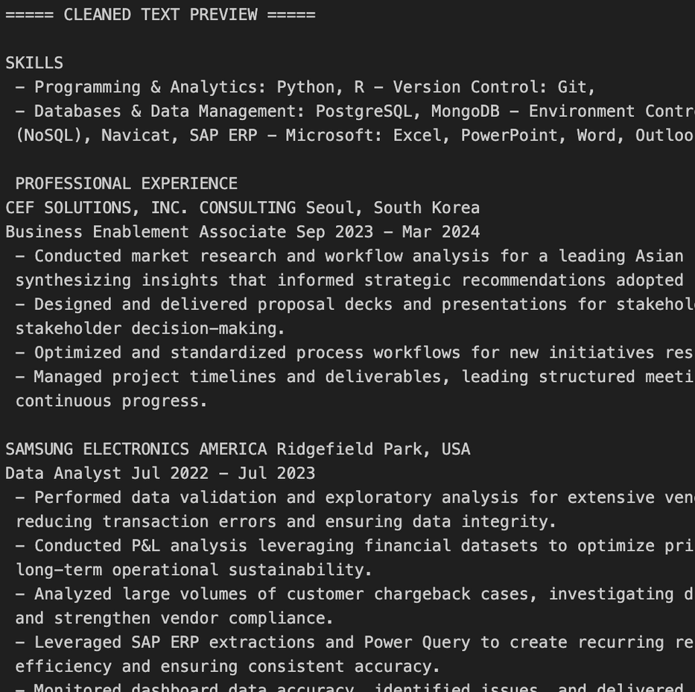
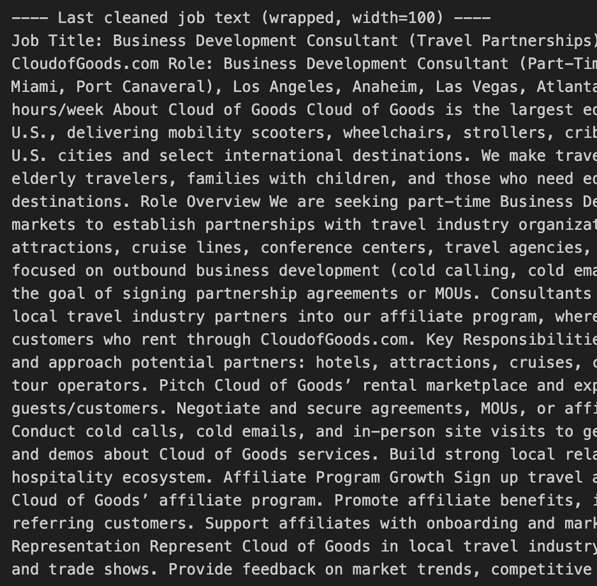
Data Cleaning - Result
Resume
Job Post

Slide 10
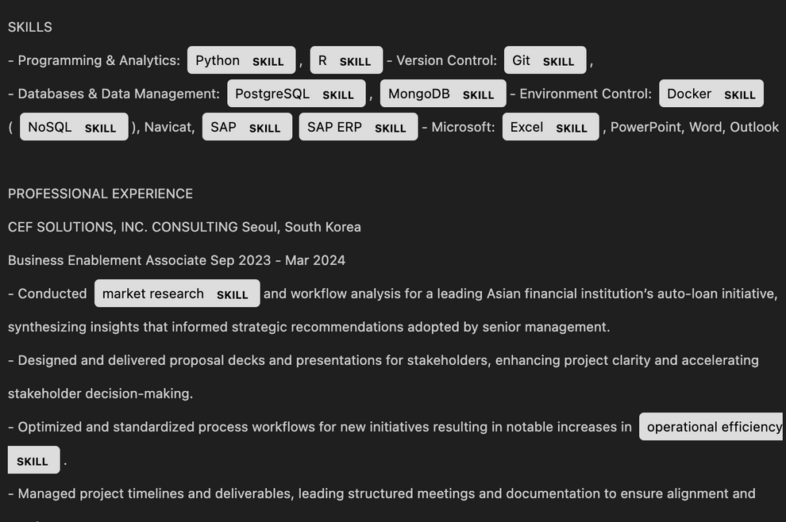
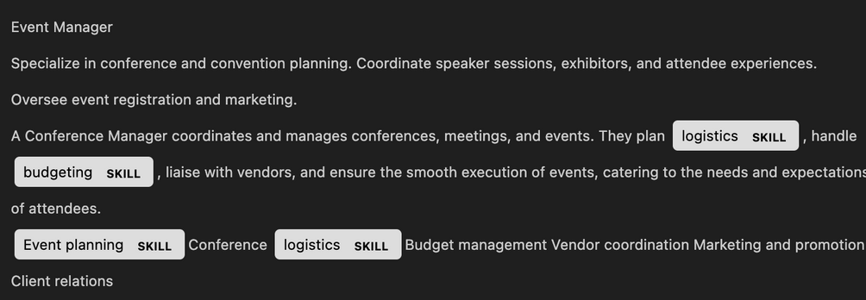
Named Entity Recognition - Skill Extraction
Modeling Pipeline
Extracted Skills - Resume
1
Custom Skill Dictionary
Master Skill Dictionary combines 530 core technical and business skills with extended multi-industry
2
Identify technical skills and keywords
Convert unstructured text into structured skill entities
Resumes
Job descriptions
3
Utilize pretrained NLP model - spaCy
en_core_web_lg ⟶ (higher accruacy)
Create a Skill Matcher using PhraseMatcher
Skill in skill list ⟶ mark them as “SKILL.”
Tokenization: Splitting text into small pieces
Name Entity Recognition: Labeling important entities in text.
Extracted Skills - Job Post
4
Final Similarity Score
Jaccard Similarity Score (Resume vs Job)

Slide 11

Named Entity Recognition - Score and Result
Example
Jaccard Similarity Score Calculation
[A] Resume Skills
{python, sql, tableau, aws}
[B] Job Description Skills
{sql, python, excel, aws, communication}
Resume Extracted Skills
Job Description Extracted Skills
Jaccard Similarity Score
Overlap = {python, sql, aws} = 3
Union = {python, sql, tableau, aws, excel, communication} = 6
Jaccard = 3 / 6 = 0.50 ⟶ 50% matched
What both sets share (overlap)
What they have in total (union)
Jaccard =∣A ∩ B∣​/∣A ∪ B∣

Slide 12
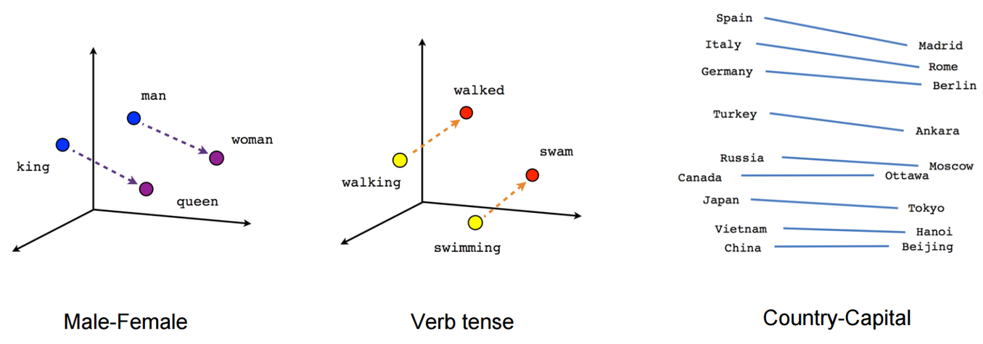
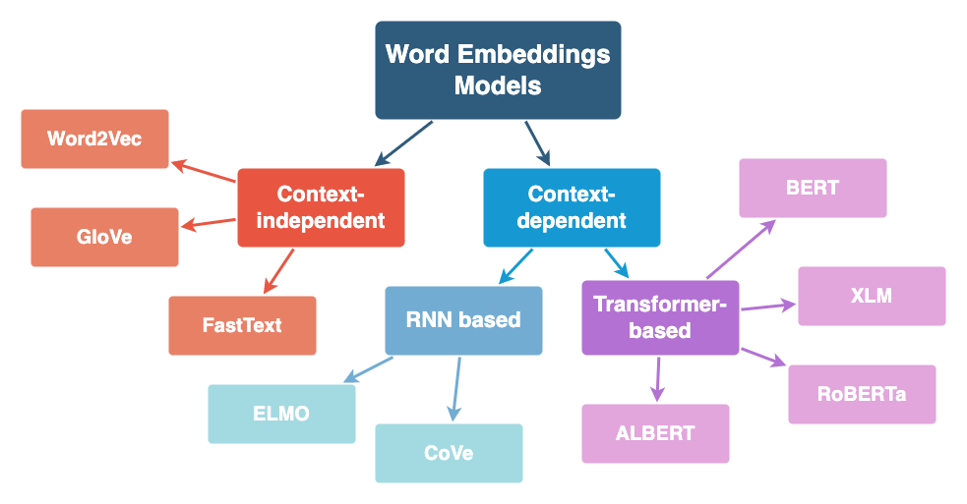
Word Embedding
How word embedding works?
Core idea → “meaning” captured via geometric distance in vector space
Numerical vector representations of text where similar words/documents → similar vectors
Why we need word embeddings in job post–resume matching ?
Enable semantic understanding beyond keyword matching
Word embeddings capture:
Role similarity
Skill relationships
Contextual meaning
World embeddings models can be divided based context dependency.

Slide 13
Word Embedding Models Tested
01
03
Word2Vec (Skip-gram)
02
SBERT (Sentence Bert)
CareerBERT (Pre-trained model)
Description:
Neural embedding model using token co-occurrence to learn word vectors
Captures basic semantic relations (e.g., “analyst” ~ “consultant”)
However, no contextual understanding due to most word vectors loses sentence structure
Description:
Transformer-based model producing sentence- and document-level embeddings
Strong contextual understanding
Handles long job/resume text accurately
Robust to synonyms & variation in writing style
Description:
Pre-trained model for career/job similarity.
Tailored for occupation matching
Domain-specific vocabulary understanding
Less stable similarity output in our testing
Final Word Embedding Model: SBERT (Sentence Bert)
SBERT consistently produced more accurate and stable rankings compared to Word2Vec and CareerBERT,
especially for resumes with varied experience levels.
Model version used: all-MiniLM-L6-v2
Dimension tested : 300 , 384, 768, and 1536.
Notes:
Each score measures a different dimension of “fit.”
They are combined through weighted aggregation to compute the overall match score.

Slide 14
Word Embedding
Modeling Pipeline
Results
Top Jobs | Score
Senior FP&A Analyst | 0.682
Senior Data Management | 0.677
Data Product Owner | 0.677
Python Developer | 0.661
Frontend Engineer | 0.654
1
Cleaned Job/Resume Text
Apply light cleaning (\n, unicode, tabs → space)
Keep punctuation & wording to preserve context
2
Full-Text SBERT Embeddings
Convert all cleaned texts to lists
Encode using SBERT latest model
Output: dimensional dense vectors
3
Cosine Similarity
For each resume, compute similarity with all jobs
semantic_score = cos(resume_emb, job_emb)
Higher score → more semantically aligned roles
4
Ranked Results
Sort jobs by semantic score (descending)
Stored the score for the final matching

Slide 15

Topic Modeling
Topic modeling compares meaning, not just keywords by mapping each resume into shared job themes
Technique Selection
Map Themes
Convert jobs into shared topics
LSA
Topic Modeling
Match resumes to jobs by
shared meaning
Works directly on TF-IDF vectors
Uses SVD to reduce dimensions
Compare Meaning
Match semantic themes beyond keywords
Fast and Efficient for retrieval
Align Roles
Connect related titles like analyst and BI
Handles short/medium texts well
Reduces noises
*We also developed the model using “LDA” as alternative technique for result comparison

Slide 16
Topic Modeling
Modeling Pipeline
Results
Top Jobs | Score
Delivery & Practice Head with verification | 0.997
Database Operations Analyst | 0.995
Application Engineer | 0.994
Director Metals & Mining Consulting - Big4 | 0.993
Research Analyst - Energy & Resources | 0.993
1
Job/Resume Cleaned Text
Cleaned input documents with job descriptions
2
TF-IDF Vectorization
Convert text to weighted term vectors (1–3 grams)
3
TruncatedSVD
Project into 120-dimensional topic space
4
Cosine Similarity
Compute pairwise match scores
5
Ranked Results
Top-N recommendations per resume

Slide 17
Results & Evaluation

Slide 18
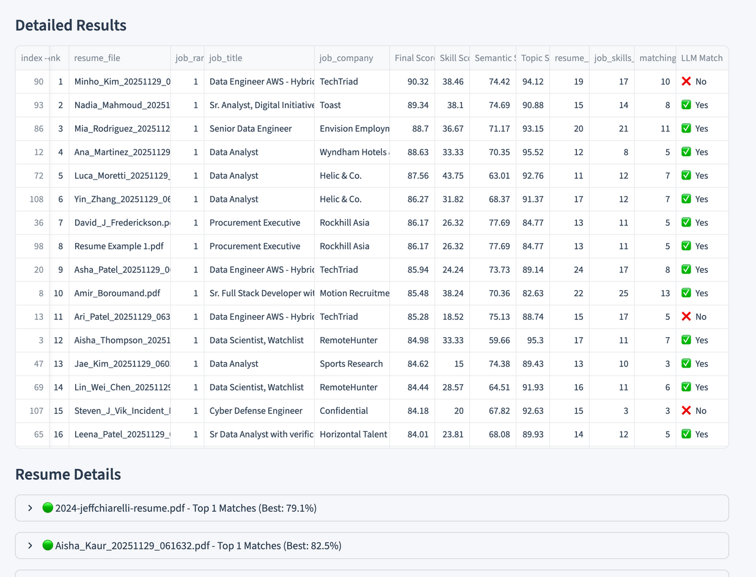
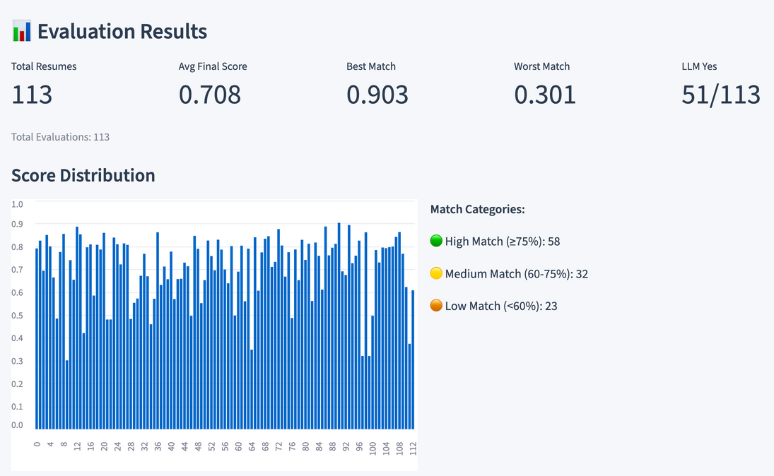
Final Matching Score Calculation
Job Matching Score Formula = avg_topic_semantic + (1 - avg_topic_semantic) * skill_score
*Screenshot from our UI, showing the statistical result and visual of our similarity score
Our Resume-Job matching model provides the final similarity score for each resume and identifies the best-matching job

Slide 19
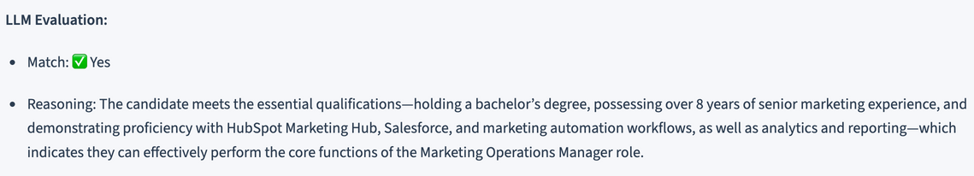
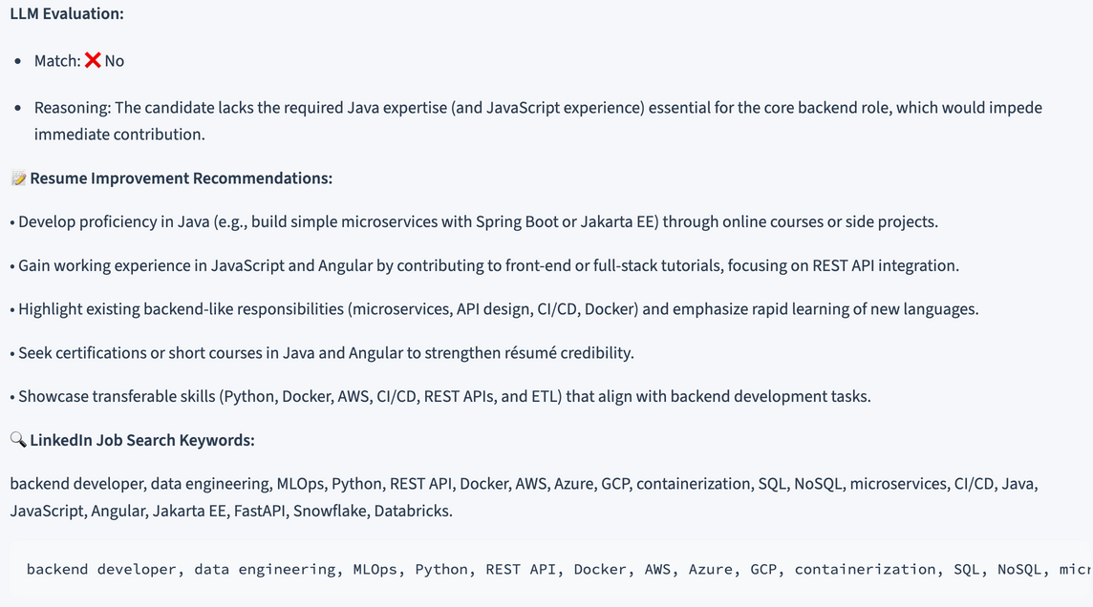
LLM Evaluation & Recommandation
*GPT-OSS:20B (DECODED ONLY MODEL) USED
Prompt Engineering
Evaluation & Resume Improvement Recommendation
system_prompt
You are an expert recruiter evaluating resume-job matches. Job descriptions often list ideal candidates with all possible skills - this is unrealistic. Focus on ESSENTIAL qualifications needed to perform core job functions. Consider transferable skills, related experience, and learning ability. A 'Yes' means the candidate can reasonably do the job, not that they have every skill listed.
*LLM Evaluates “Yes matching”
prompt_template
Evaluate if this resume matches this job posting. Be practical and realistic.
JOB POSTING:
Title: {title}
Description: {job_text}
RESUME:
{resume_text}
EVALUATION APPROACH:
1. Identify 3-5 CORE skills/requirements essential for this role (ignore nice-to-haves)
2. Check if candidate has these core skills OR transferable/equivalent experience
3. Assess if candidate's experience level aligns with role expectations
4. Consider: Can they reasonably perform the core job functions? If yes → "Yes"
DECISION RULES:
1.Answer "Yes" if: Candidate has essential qualifications OR strong transferable skills that indicate they can learn/adapt
2.Answer "No" only if: Missing critical core requirements that would prevent basic job performance
OUTPUT FORMAT:
Line 1: "Yes" or "No"
Line 2: One-sentence explanation
If "No", then:
Line 3: "RECOMMENDATIONS:" followed by 3-5 specific, actionable recommendations
Line 4: "LINKEDIN_KEYWORDS:" followed by 5-10 relevant job search keywords
*LLM Evaluates “Not matching”

Slide 20
Evaluation Result
LLM as a Judge
Collected 113 resumes (45 real and 68 synthetic) from peers representing a wide range of roles
Each resume includes the user’s actual current job title as ground truth for evaluation
Metrics
LLM-Verified Top-1 Match Rate
→ Percentage of resumes where the LLM answered “Yes” for the #1 recommended job.
LLM-Verified Top-3 Match Rate
→ Percentage of resumes where the LLM answered “Yes” for any job in the Top 3 recommendations.
Metric | Usage | Evaluated Match % | Logic
Top-1 Match % | Strict Accuracy | 38.34% | Evaluates the model’s ability to place the correct job at the very top of the ranking.
Top-3 Match % | Practical Usage | 41% | Evaluates overall recommendation quality and relevant alternative quality beyond the top choice.

Slide 21
Findings & Conclusion
Findings
Conclusion
Scalability
Geographical Scale: job listings with multilingual support
Data Scale: Expand data collection across multiple job platforms and company sources
Enable real-time system integration for continuous job and resume processing.
Liscensing
Partner with job-posting platforms and companies for more diverse job descriptions.
Business Value
This technique can be implemented in existing ATS systems for companies, not just as a tool for job seekers.
The job-matching system that combines skill matching with semantic matching produced strong results
From NER skill extraction reveal that job titles may vary, but the core responsibilities in the job description are usually consistent.
LLM evaluation result always change every time we tested by nature
SBERT’s semantic score improved the relevance of Top-job matches. SBERT’s also worked well to understand synonym and variation of writing style.
Adding grams (1-3) and topics (120) helps improve the result in Topic modeling, and Using LSA runs much faster than LDA

Slide 22
Limitations & Opportunities for Improvement
What We Could Have Improved With More Time
Expand and refine the skill dictionary for higher coverage
Automate normalization and tuning for SkillScore, SemanticScore, and TopicScore
Incorporate experience years to better reflect seniority and adjust match quality
Expand the job post dataset with a wider range of industries to improve model generalizability.
Where the Demo/App Breaks
Fails when job descriptions contain missing fields or extremely short/empty text
UI may freeze for very long job descriptions or large batch uploads
LLMs have token limitations during evaluation, which can lead to reduced performance in cases where resumes or job descriptions contain long or complex text.
The app currently supports only PDF-format resumes, which limits flexibility for users with other file types.

Slide 23
UI Demo

Slide 24
Thank You
APAN 5430 - Group 4

Slide 25
Reference
Zielinski, D. (2023, December 21). Is your applicant tracking system hurting your recruiting efforts? SHRM. https://www.shrm.org/topics-tools/news/hr-magazine/applicant-tracking-system-hurting-recruiting-efforts
Cappelli, P. (2019, May 1). Your approach to hiring is all wrong. https://hbr.org/2019/05/your-approach-to-hiring-is-all-wrong

